Slide 1


Treatment Pre-Solicitation Open House
May 8, 2024
Kim A. Kaleta
Chief U.S. Pretrial Services
Officer
Rocky Reyes
Deputy Chief U.S. Pretrial Services Officer
Tamika L. Baxley
Intensive Supervision Specialist
Jana G. Law
Chief U.S. Probation Officer
Manuel Jimenez
Deputy Chief U.S. Probation Officer
Jonathan J. Henshaw
Assistant Deputy Chief
U.S. Probation Office

Slide 2

Freedom from Self Doubt… BJ Davis

Slide 3


Welcome: Kim A. Kaleta, Chief U.S. Pretrial Services Officer
Jonathan J. Henshaw, Asst. Deputy Chief U.S. Probation Officer
Housekeeping: Tara Sawicki
Panel of Specialists: Rocky Reyes, Kelly Duley-Butts (U.S. Pretrial Service Office)
Valerie L. Riedel, Julia Roberts, and Melanie Fields (U.S. Probation Office)
Request for Proposal (RFP): Sections A-M: Tamika Baxley and Panelists
Sections A-B:
Section C- G:
Sections H-J:
Sections K-M:
Invoices/Billing: How Does my Agency Get Paid:
Kelly Duley-Butts, Procurement Specialist & Deputy Chief U. S. Pretrial Services Officer Rocky A. Reyes;
Melanie Fields, U.S. Probation Office
Treatment Procedures: Tamika L. Baxley. (Pretrial Services) & Melanie Fields (Probation Office)
What’s Next?: Tamika L. Baxley and Melanie Fields
Question and Answer Session

Slide 4
Request For Proposal (RFP) Sections
Section A - Solicitation Offer/Acceptance
Section B – Supplies or Services and Offeror’s Prices
Section C – Description/Statement of Work
Section D – Packaging and Marking
Section E – Inspection and Acceptance
Section F – Deliveries or Performance
Section G – Agreement Administration Data
Section H – Special Agreement Requirements
Section I – Required Clauses
Section J – List of Attachments
Section K – Representations, Certifications and Other Statements of Offerors or Quoters
Section L – Instructions, Conditions and Notice to Offerors
Section M – Evaluation Factors for Award

Slide 5
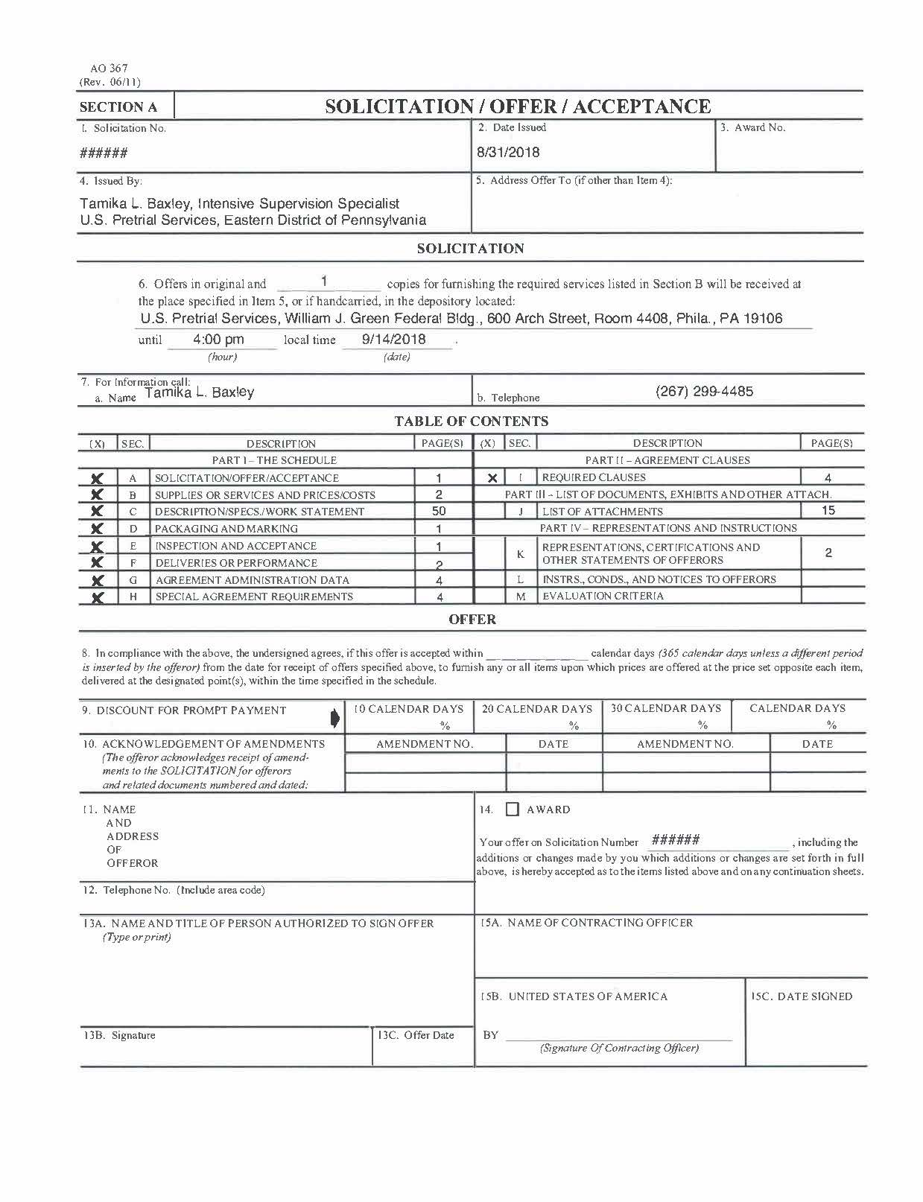
Section A
Notes:
Tamika

Slide 6
Section B:
Supplies or Services and Offeror’s Prices
Notes:
Services – Refer to Section B
Catchment Area – Defines a geographic area in which vendor must provide services. Requires brick and mortar facility.
Estimated Monthly Quantities (EMQ) are expressed in units. Unit measurement can be different depending on project code. (Section B)
Unit Prices

Slide 7
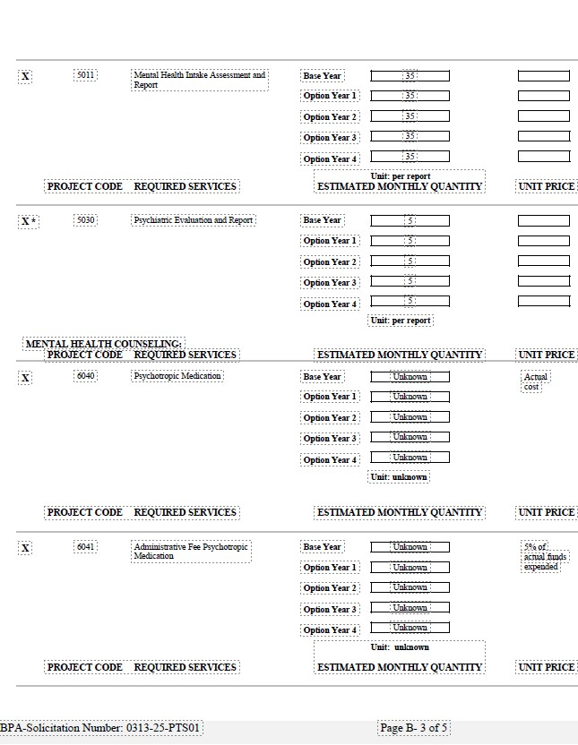

Slide 8

Section C:
Description/Statement of Work
Introduction
Provisions of Services
Definitions
Mandatory Requirements
  General Requirements
  Notifying USPO/USPSO of defendant/person under supervision behavior
  Staff Requirements and Restrictions
  Facility Requirements
  Local Services (if applicable)
  “The vendor shall perform…”

Slide 9
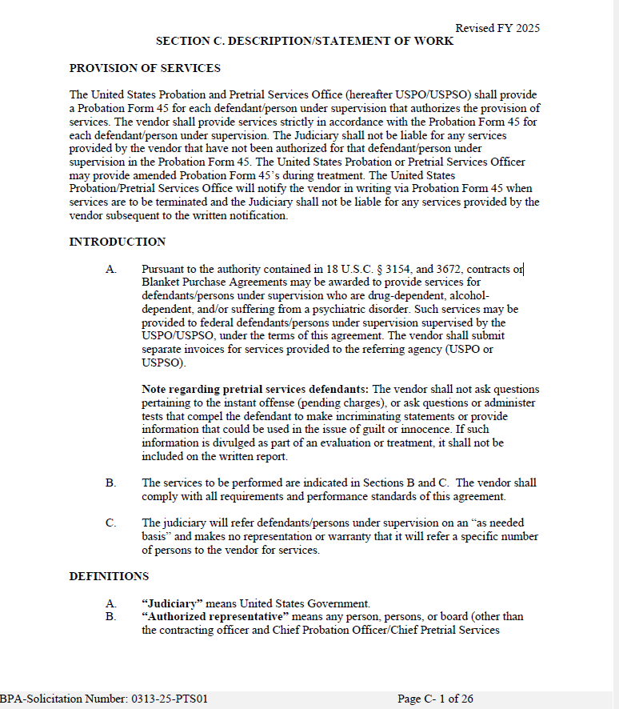

Slide 10

Section E:
Inspection and Acceptance
Vendors Performance (Mandatory Requirement)
Clause B-5 Clauses Incorporated by Reference
http://www.uscourts.gov/procurement.aspx

Slide 11
Vendor shall have capability to immediately place Federal client’s outpatients/assessments/
testing/evaluation/treatment or drug/alcohol
testing without regard to a backlog or waiting lists.
Residential placements - first available bed space
Vendor shall not refuse service without approval of the Government (take appropriate and immediate action to protect staff and clients).
Vendor shall not unilaterally refuse services to any defendant/person under supervision referred by the Judiciary, except where the defendant/person under supervision poses an apparent danger to the vendor’s staff or other clients. The vendor shall not deny access to services solely based on the defendant/person under supervision’s current participation in medication-assisted treatment (MAT), medical condition, disability, religion, ethnic origin or criminal record.
Section F: Deliveries or Performance

Slide 12
The vendor shall not refuse without approval of the Judiciary.
Termination of defendant/persons under supervision from treatment or other authorized services, based upon a violation of the vendor’s program rules and regulations shall not be made without the approval of the Judiciary.
Vendor shall perform and comply with mandatory requirements set forth in Sections C, E, F and G, H and I of this contract. Vendor’s noncompliance or failure to do so shall be the basis for termination of the contract or agreement.
Section F: Deliveries or Performance

Slide 13
Section G:
Agreement to Administration of Data
Contact Point for Assistance
Fiscal Records (mandatory requirement)
Invoices
  Submit original copy and supplemental documents
  Submit by 10th of the month
  Use Approved Invoice Forms (Part A, B, monthly sign in log.
  Electronic signature is acceptable
  Units of Service

Slide 14
G.3 Vendor Invoice Documentation
In accordance with Section G-1-4, vendors must submit:
  Monthly Invoice Parts A and B
  Monthly Sign In Log
  Documentation of any vendor related travel
  Psychiatric evaluations
  Medication
  Transportation Receipts

Slide 15
Part
A
Notes:
Must be complete and include an authorized signature.

Slide 16
Part
B

Slide 17
Monthly SIGN IN LOG

Slide 18
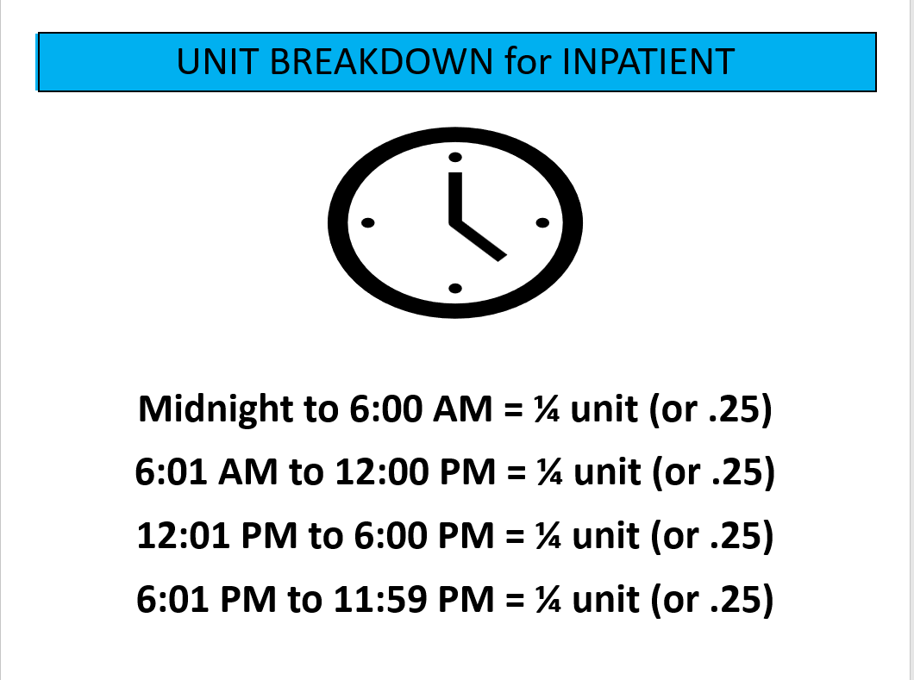
Notes:
Using the time a defendant/person under supervision was admitted to or discharge from the facility,
Admission – calculate units in a descending motion
Discharge – calculate units in an ascending motion

Slide 19
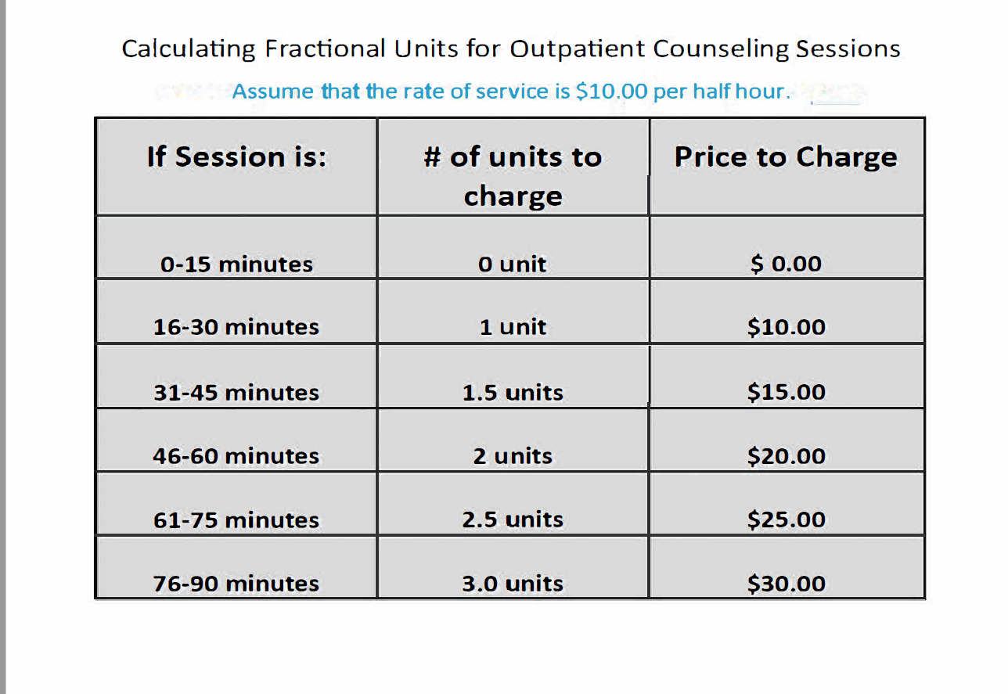

Slide 20
Certification Overview
Certification includes a series of tasks that compare the invoice with several documents
Summary of comparisons
Invoice to Agreement terms
Invoice to Program Plan (Prob 45)
Invoice to supporting vendor documentation
Invoice to Clinical Service Module

Slide 21
Receive
Receive invoice by the 10th
Compare
Compare invoice to BPA
Ensure only the services on the BPA/NCPO are on the invoice
Verify that the service is on the BPA/NCPO and the correct unit price has been billed
Verify vendor name and number match the BPA/NCPO
Compare
Compare the invoice to the Program Plan (Prob 45)
To ensure services ordered on Prob 45 were performed
Verify services invoiced were approved on the plan
Certification Process

Slide 22
Certification Process (continued)
Compare invoice to vendor documentation
  Provide checks and balances
  Verify that forms are complete, signatures are included, services were performed as requested
  Includes copayments received
  Administrative Fees 1501, 6041, 1201, 7021
Compare Invoice to Validation Report
  Enter data into Clinical Services Module for price and service comparison
  Certify the invoice for payment
Chief approves the invoice with signature/payment certification
Treasury remits payment to vendor
Notes:
5% administrative fees for collection of copayments and 6040 medication costs (only by request and approval of the Chief U.S. Pretrial Services Officer). These are not billed by client but one sum for the total of all costs.
Level 1 approval. Then Chief gives final approval.

Slide 23
Section H: Special Agreement Requirements
Indemnification
Drug-Free Workplace
Government Furnished Property

Slide 24
Section I: Required Clauses
Subcontracting
Option to Extend the Term of the Contract
Option to Extend Services
Clauses Incorporated by Reference
http://www.uscourts.gov/procurement.aspx
Notes:
Clauses
Subcontracting - Prime contractor is responsible to the judiciary for overall performance of the services required under the contract. If any services are subcontracted, the prime contractor shall ensure that the subcontractor is complying with the requirements of the contract. A subcontractor has no contractual rights against the judiciary.
Options to Extend the Term of Contract. Will provide written notice no later then 30 days prior to expiration. Duration shall not exceed 3 years.
Option to Extend Services
Clauses Incorporated by Reference – Full text of clause may be accessed electronically via www.uscourts.gov/procurement.

Slide 25
Section J:
Forms & Attachments
Notes:
Examples of what is included in this section. Forms will also be available on our internet page.

Slide 26
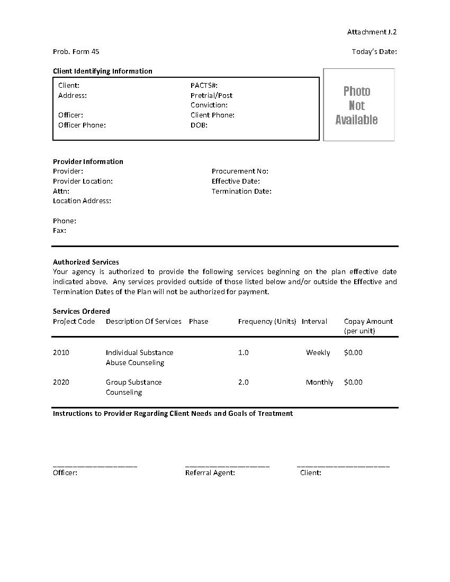
Probation 45 Contract

Slide 27
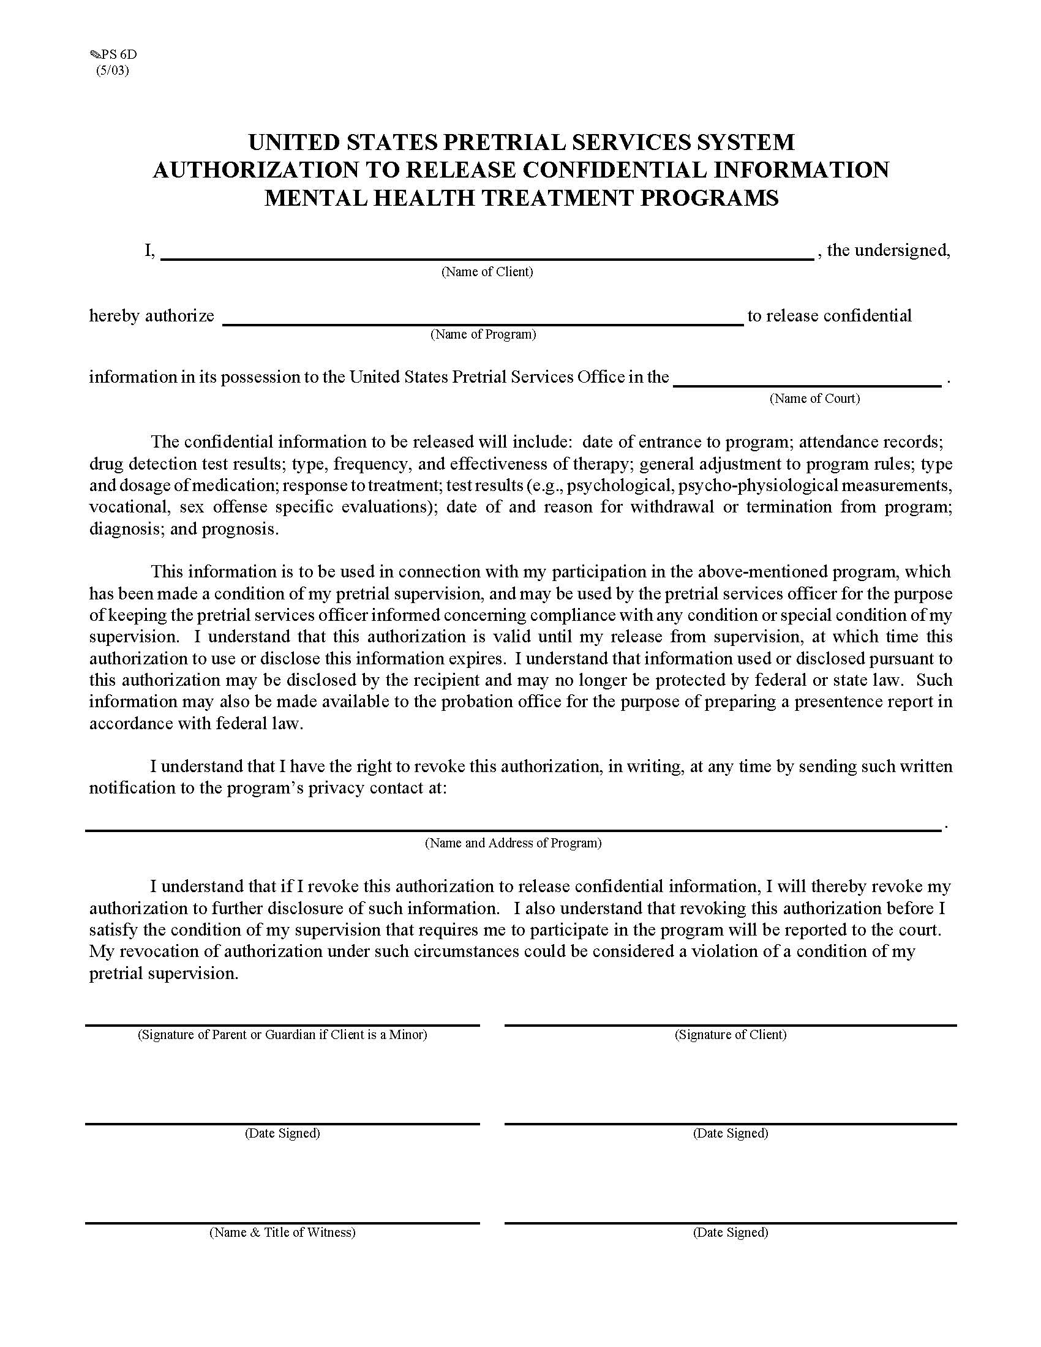
Mental Health Release

Slide 28
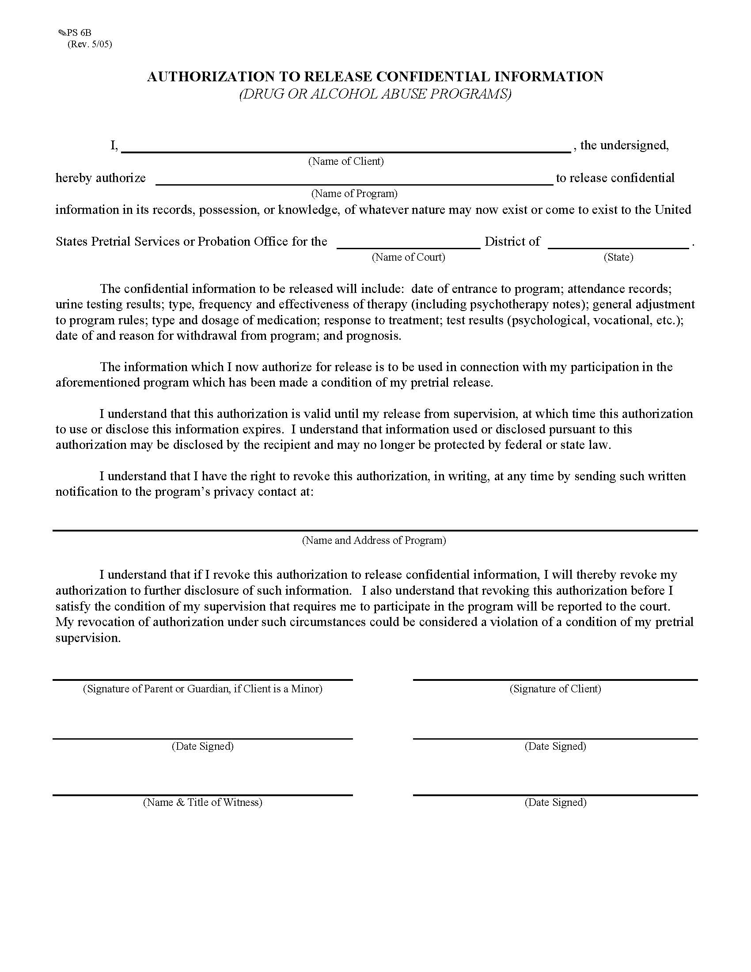
Drug and Alcohol Release

Slide 29
Required forms and attachments are referenced above in slides # 14-17.
Post COVID-19, additional letters will include telemedicine letters confirming services were rendered.
When a defendant is unable to sign the monthly sign in log, please include a letter with the dates of attendance and # of hours. Please sign the letter and attached the letter to the monthly sign in log and invoice.
Psychiatric Evaluations should be emailed to the Officer within 15 days of service. They should be typed.
For MAT Services, please include the typed physical lab report with the invoice as well.

Slide 30
Section K – Representations, Certifications and Other Statements of Offerors or Quoters
Notes:
This two-page section must be submitted.
Authorized Negotiator must be listed with contact information
Taxpayer Identification and Other Offeror Information

Slide 31
Section A
Checklist
References
Lowest Price and Technically Acceptable
On-Site Visit
Section L & M:
Evaluation Criteria

Slide 32
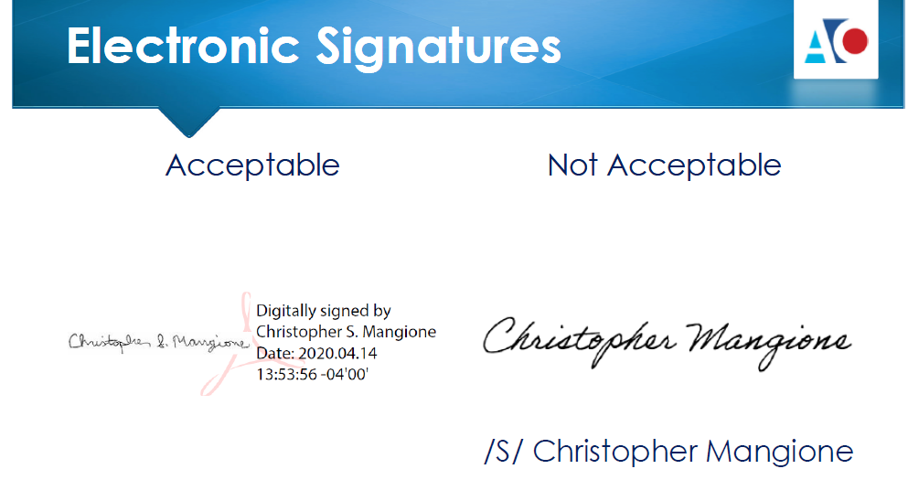
Electronic Solicitation Process
Via Internet and Email
Notes:
How to submit via email
 If the file is too large it can be sent as multiple files
 Offeror should confirm receipt after submission

Slide 33
Evaluation of Proposals
Only those proposals received by the solicitation’s specified deadline are considered timely and eligible for evaluation and award.
Four key factors are used to award a BPA:
  Technical Acceptability Evaluation
  Price Evaluation
  On-Site Evaluation
  Responsibility Determination
To be acceptable and eligible for evaluation, proposals shall be prepared in accordance with the instructions given in Sections B and L.

Slide 34

By submission of proposal, the offeror accepts all the terms and conditions of the RFP. Proposals that take exception to the terms and conditions will be determined technically unacceptable and the offeror will be so advised.
All proposals are evaluated using pass/fail criteria:
  Mandatory Requirements
  Past Performance
  Site(s) at which services are provided
  Staff Qualifications
  Offeror has to register with www.Sam.gov for payments
  Background Disclosure (discuss)

Slide 35
Determining Responsibility and verifying vendor enrollment in sam.gov:
Part of determining responsibility prior to making an award requires checking the GSA’s Excluded Parties List System (EPLS) through System for Award Management (SAM) – sam.gov.
Section I includes the following language re: Clause 3-300 Registration in the System for Award Management (Apr 2013): The Offeror shall register in the System for Award Management (www.sam.gov) at the time an offer is submitted. Note: if awarded, the Offeror shall maintain registration in www.sam.gov. Failure to do so could result in delay in payments.
A Sam.gov registration will be required to verify if vendors have an active registration. Sam.gov checks should be done prior to awarding agreements, POs, BPAs, etc. Sam.gov registration doesn’t require any connection to JIFMS.

Slide 36
How does my Agency get paid?

Slide 37

Award Procedures
When evaluations have been completed and the Contracting Officer (CO) has made the final selection of the vendor(s), you will receive an award letter, the signed AO Form 367 (Solicitation/Offer/Acceptance). AO Forms 347 (Order for Supplies or Services) and 348 (Page 2) will be provided as well.
Services will be procured with a Blanket Purchase Agreement (BPA) or Non-competitive Purchase Order (NCPO). BPA is 12 months with four 1-year options. The NCPO is 12 months or less with no option years.

Slide 38

Post Award Procedures
More than 1 Vendor May be Selected – Estimated Monthly Quantities (EMQ) Divided Accordingly
Monitoring Visits
This Photo by Unknown Author is licensed under CC BY-SA

Slide 39
Officer’s Treatment Procedures
Initial Assessment
Pretrial Services Treatment Procedures: Case staffing shall occur: (1) A minimum of every 30 days for high and moderate risk referrals; (2) A minimum of every 30 days, regardless of risk level, for residential treatment placements; (3) A minimum of every 90 days for all other clinical services referrals; and (4) as requested by the USPO/USPSO.
U.S. Probation Offices Treatment Procedures.
Amended Prob45: Treatment services can begin only after an amended Prob45 Contract is provided to the treatment provider by the officer authorizing specific treatment services.
For Pretrial referrals, defendants classified as Pretrial Risk Assessment Tool (PTRA) categories 3, 4, and 5 should be staffed a minimum of every 30 days; whereas defendants classified as PTRA 1 and 2 categories will require staffing a minimum of every 90 days.

Slide 40
Factors to Consider
The total amount of treatment for any individual must last at least 90 days.
Co-occurring Disorders should be treated in an integrated way. If there are multiple providers treating an individual, release of information forms should be signed for communication among providers.
As treatment needs change, the Probation 45 contract must be amended to reflect the true current needs.
Communication is key. The officer and treatment provider should be communicating on a regular basis about changes in an individual’s life that could affect treatment (e.g., changes in employment, changes in relationships, etc.).

Slide 41

Other Factors (Continued)
The only services that can be provided by the treatment provider are the services authorized on the Probation 45 contract. As most pretrial services officers are NOT licensed counselors, officers correctly rely heavily on the recommendations from the treatment professional; however, the final decision for approved services is made by the pretrial services officers, supervisors, and Chief U.S. Pretrial Services Officer. (Pretrial Services Officers often must consider court-mandated treatment conditions, availability of funds, etc., which might not always align directly with a treatment provider’s recommendation.)

Slide 42
Information Specific to U.S. Probation Treatment Services:
The individuals receiving services are Post-Conviction and serving a term of Probation (never went to custody) or Supervised Release (following a term of custody);
Treatment will generally be for a more defined period and a shorter-term (depending on the individual clinical needs);
Slightly different release of information forms compared to the Pretrial Forms.

Slide 43
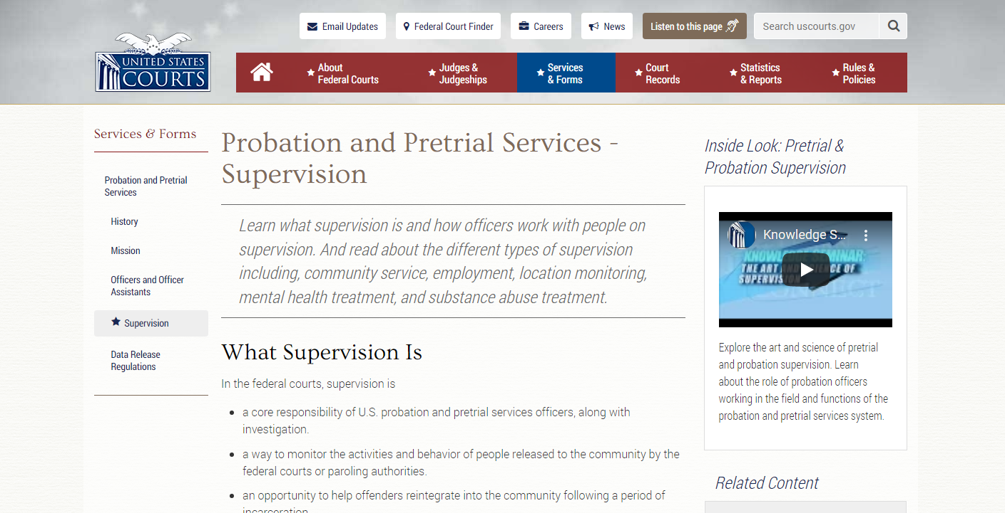
https://www.uscourts.gov/services-forms/probation-and-pretrial-services/supervision/post-conviction-risk-assessment

Slide 44
What’s Next?
The U.S. Pretrial Services and U.S. Probation Services Websites will go live on June 1, 2024
Go onto the Website:
Use the Client Treatment Tab
Then use the Solicitations Tab to access the RFP

Slide 45
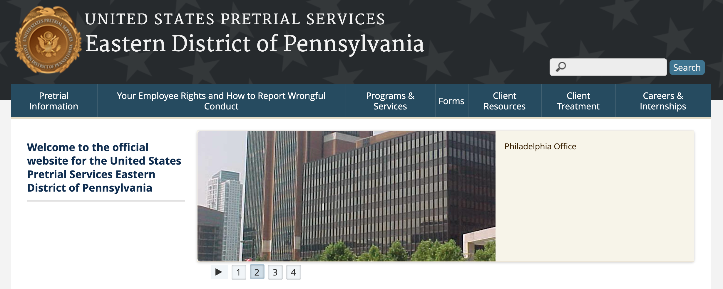
Web Site:
https://paept.uscourts.gov
Notes:
Tamika – Pretrial Services Internet site is live now, and solicitations have been posted. There is a section for Mental Health, Drug, Integrated Treatment Services; Antagonistic/Suboxone Maintenance, and Residential Housing.

Slide 46
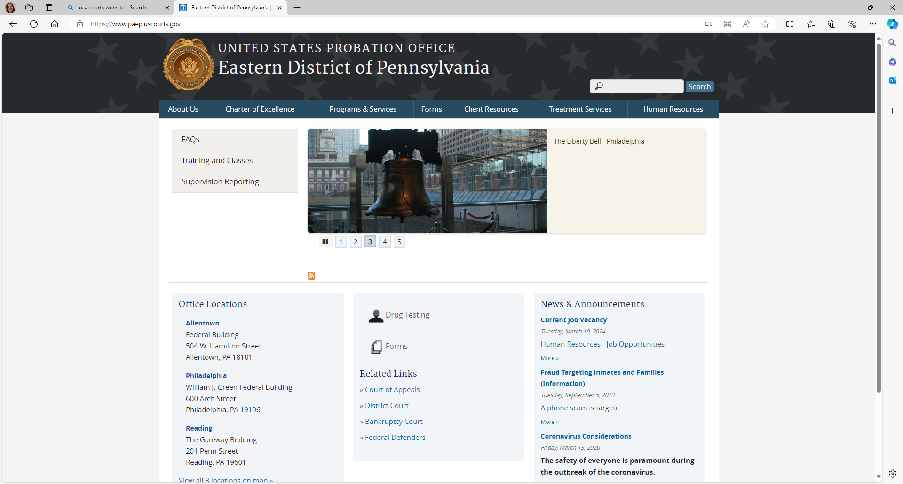
U.S. Probation Office Web Site:
https://www.paep.uscourts.gov

Slide 47

Question & Answer Session

Slide 48

Contact Point for Assistance:
Tamika L. Baxley, Intensive Supervision Officer
Tamika_baxley@paept.uscourts.gov
Office: (267) 299-4485
Cell: (267) 366-8422
Kim A. Kaleta, Chief U.S. Pretrial Services Officer
Kim_Kaleta@paept.uscourts.gov

Slide 49
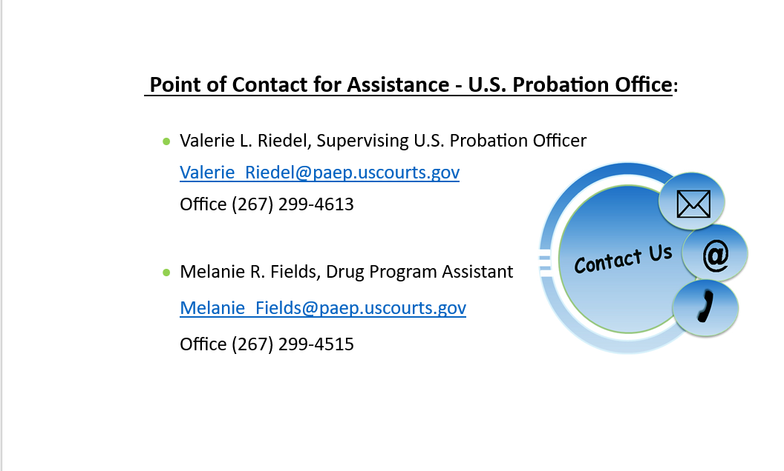

Slide 50
“Mini” Literature Review for an Overview of Post-Conviction Evidence-Based Practices:
Administrative Office of the United States Courts Office of Probation and Pretrial Services Federal Post Conviction Risk Assessment Research Compendium (March 2018)Retrieved https://www.uscourts.gov/sites/default/files/federal_post_conviction_risk_assessment_research_compendium_0.pdf
Bonta, J. & Andrews, D. Risk-Need-Responsivity Model for Offender Assessment and Rehabilitation. Public Safety Canada. (January 2007) Retrieved from https://www.researchgate.net/publication/310747116_Risk-Need-Responsivity_Model_for_Offender_Assessment_and_Rehabilitation
Johnson, J.Lowenkamp,C. VanBenschoten, S., Robinson, C. The Construction and validation of the federal Post Conviction Risk Assessment (PCRA) (September 2011) Federal probation 75(2)
file:///F:/Julia%20Roberts/PCRA%20foundation%20article.pdf
Lovins, B., Cullen, F., Latessa, E., and Johnson, C. Probation Officer as Coach: Building a new professional identity. (Federal probation June 2018 Vol 82(1) 13-19.
Lowenkamp, C., Latessa, E., Holsinger, A. The Risk Principle in Action: What Have We Learned From 13,676 Offenders and 97 Correctional Programs? January 1, 2006
Robinson, C., VanBenschoten, S., Alexander, M., and Lowenkamp, C. A Random (Almost) Study of Staff Training Aimed at Reducing Re-arrest (STARR): Reducing Recidivism through Intentional Design. Probation Journal 75(2)
Walters, G., Trgovac, M., et. al. Assessing change with the Psychological inventory of criminal thinking styles: A controlled analysis and multisite cross-validation. Criminal Justice and Behavior June 2002 29(3) 308-331

